Slide 1

Advisor for one day travel
by Anton Dziavitsyn 2019

Slide 2
Advisor for one day travel
What to do if you have only one day for visit?
It is the case, when we should find one place to visit in town, which will contain most interesting and rated venues. Because we have not much time, and we want to go to one location by transport and just walk and look around.
So main goal of that project is to create Advisor, which can advise to us what part of town we should visit at one day.
by Anton Dziavitsyn 2019

Slide 3
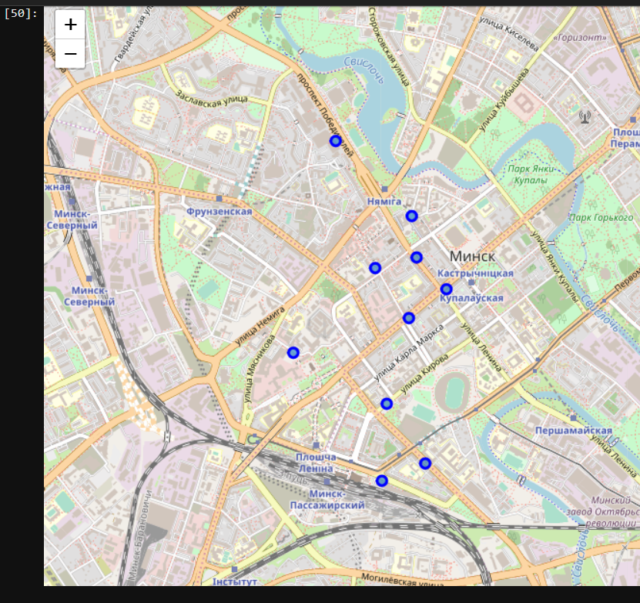
Advisor for one day travel
We defined our parameters as:
Location: Minsk, Republic of Belarus
Interests: 'restaurant', 'museum‘
MaxPriceTier: 3
Advisor does the follows:
Finds 253 categories which are satisfy our Interests
Finds venues in town which satisfy categories and price
Gets TOP rated and social active venues
Group them by location (to get clusters with near located venues)
Finds cluster with maximum venues count
Shows them on map
by Anton Dziavitsyn 2019

Slide 4
That is it! Thank You for your attention!
by Anton Dziavitsyn 2019

